Slide 1

Your name| your.email@adress.com madC Ambassador for EnterCountry

Slide 2

What is IEEEmadC?
IEEEmadC stands for Mobile Application Development Contest
Teams between 1 and 3 members
All IEEE student members are eligible to participate in madC (undergraduate, graduate, phd)
You can win valuable prizes

Slide 3
Contest goals
Increase number of mobile applications related to IEEE and students
Applications developed in this contest should be focused to benefit IEEE, technology, science or education
Educate and encourage students to develop mobile applications
Promote IEEE activities and benefits

Slide 4





Supported mobile platforms - All

Slide 5
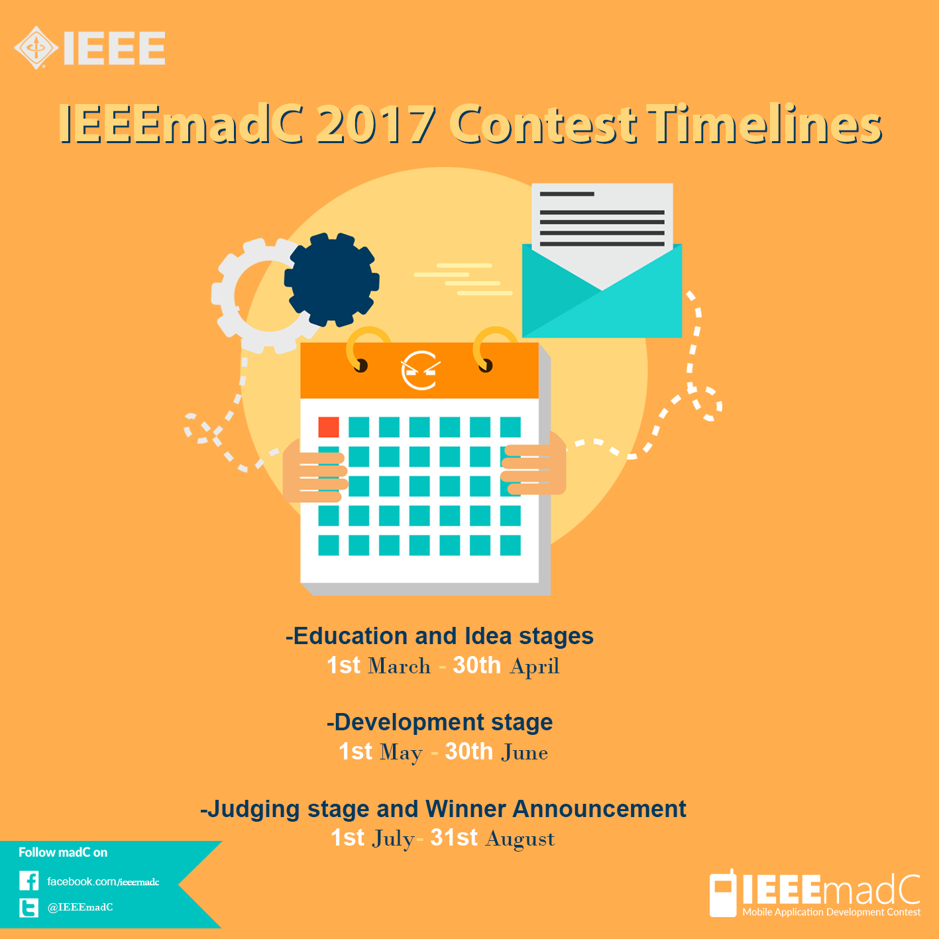
Contest stages 2017

Slide 6
Contest stages 2017
Education & Idea submission
1st March – 30 Apr 2017
Workshops / lectures at local branches,
App development
1 May– 30 June 2017
Development of mobile applications according to the submitted idea
Judging & Award
1st July – 31st August 2017
Apps judging and winner declaration.
Describe app idea (max. 150 words) and then wait for approval

Slide 7
Judging criteria
UI Design – design of the User Interface and graphic elements
User Experience (UX) – functionality, efficiency, logical structure
Usefulness – providing useful information to users, effectiveness and efficiency
Innovation and Uniqueness – difference from the mobile apps currently available, app niche
Number of supported platforms

Slide 8
Winners Categories
First Prize - TBD
Second Prize - TBD
Third Prize- TBD
Computer Society Special Prize – for Computer Society student members

Slide 9





Stats of IEEEmadC 2016
188 ideas (280+ participants)
44 developed app
+12000 likes on Facebook
5 winner teams

Slide 10
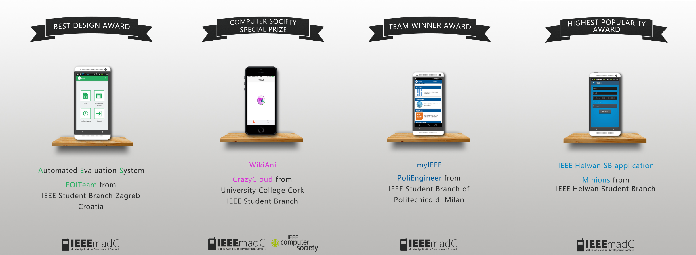
2014 winners

Slide 11
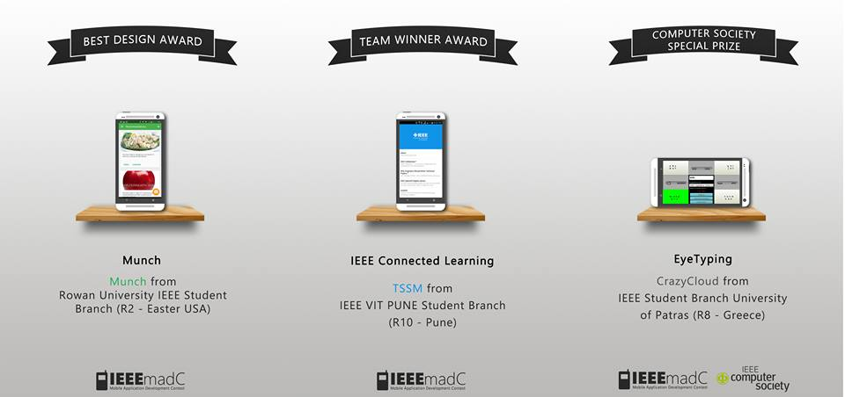
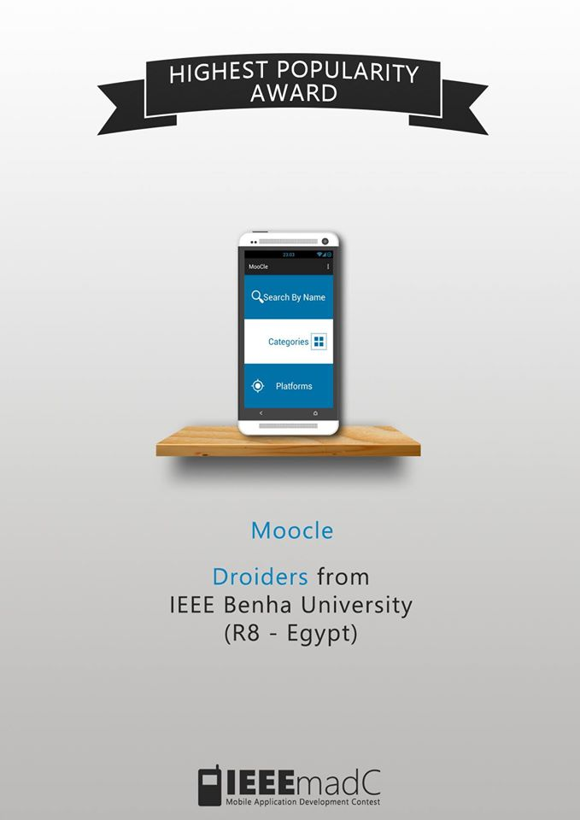
2015 winners

Slide 12
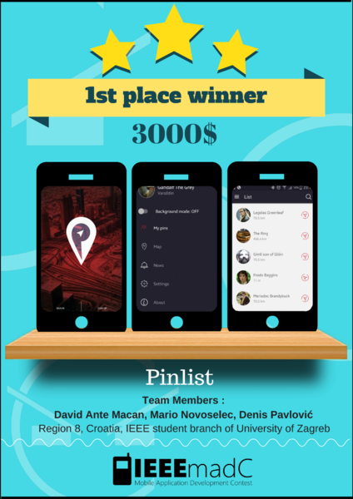
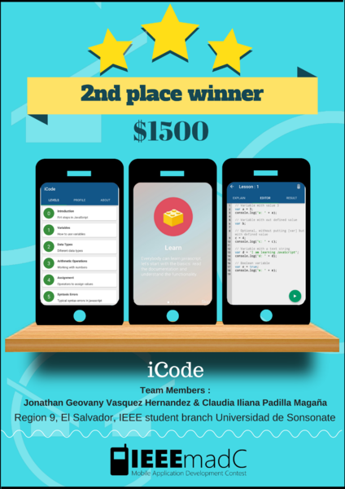
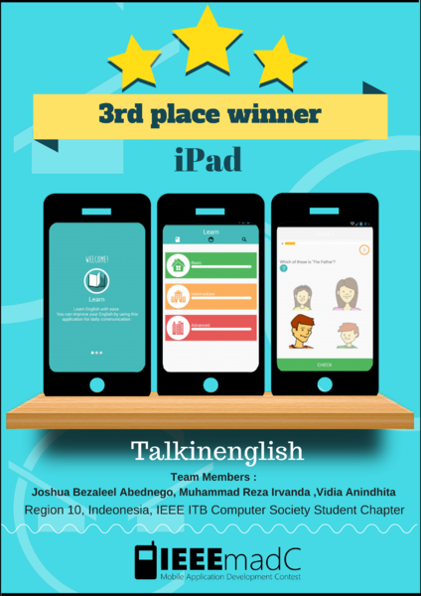
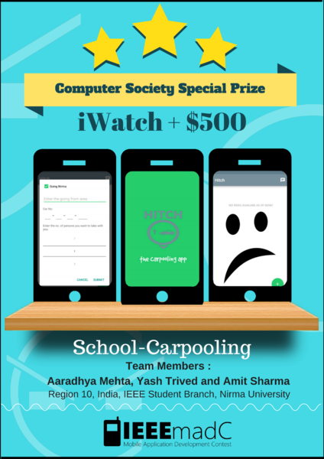
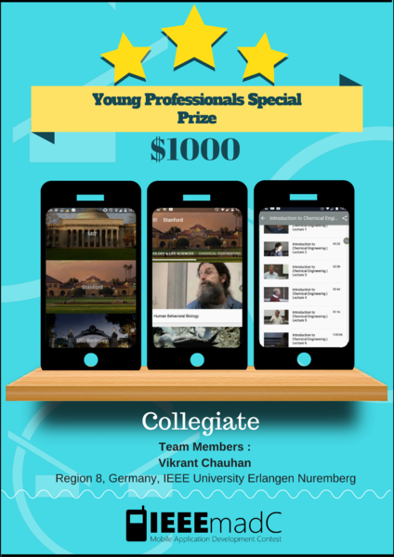
2016 winners

Slide 13
Useful links
For more information visit official web page: www.ieeemadc.org
Like us on facebook page: https://www.facebook.com/IEEEmadC
Follow us on Twitter: https://twitter.com/IEEEmadC (#IEEEmadC)

Slide 14
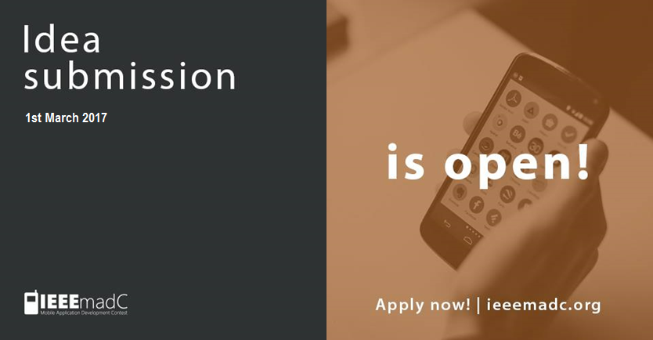
Submit your ideas now!

Slide 15


Slide 16
Thank You for attention! www.ieeemadc.org

